Slide 1
UNIT-4 : Avoiding risks and harmful habits
Effects and health hazards from addictions

Slide 2
Health Hazards
• Health issues: Cardiovascular, digestive and renal impairment, strokes, HIV/Aids, Cancer, Hepatitis B and C, Lungs, Fetal Alcohol Syndromes, etc.
• Mental health issues: Anxiety, depression, Schizophrenias, organic mental disorders due to substance abuse, cognitive dysfunction, personality disorder, etc
• Social health issues: Stigma, disrupted families, anti-social behaviours, higher crime records and law & order problems.

Slide 3
Health Effects
The damage caused by substance abuse depends on the type of drug abused and the duration of abuse. The following factors also influence the severity of the problems that follow drug abuse:
Age: The damage is greater among adolescents as well those who are above 50 years of age.

Slide 4
Nutrition status and living conditions: Poor quality and inadequate quantity of food, unhygienic living conditions and poor access to health care increase the problems caused by drug abuse.
Health condition prior to abuse: The damage is less among individuals whose physical condition is good, as compared to individuals whose health was poor even before the onset of addiction.
Genetic loading factor: A family history of a specific medical or psychiatric problem makes the individual more susceptible to the same problems in comparison to another drug abuser who is not genetically prone to the disorder.

Slide 5
Medical and psychiatric complications due to substance abuse:
a)Problems due to intoxication
Trauma or other physical injury: Mood changes caused by drugs reduce inhibitions as well as increase negative feelings leading to violence.
Driving vehicles or operating machinery under the influence of alcohol/ drugs causes accidents and injury.
Poor judgment and poor coordination can cause physical injury or even death.
Perceptual distortions can also result in accidents.
Acute intoxication reaction.
Coma and overdose deaths.

Slide 6
b) Problems due to withdrawal-Physical withdrawal symptoms of varying intensity occur as part of withdrawal.
c) Psychiatric disorders associated with substance abuse-Psychoactive substances can induce psychotic disorders during or immediately after use such as cannabis.
d) Systemic disorders associated with substance abuse

Slide 7
Dermatological complications-
When the same vein is used to inject the drug, repeated injections leave marks on the vein. The discoloration along the vein leaves dark lines called needle tracks.
Tattooing and scarring in IV drug users at injecting site.
Use of infected needles can cause infection at the injection site.
Pruritis and dermatitis

Slide 8
Cardio-vascular complications
Infection in the heart
Blocking circulation: Repeated injections at the same site can cause blood clots or air bubbles (emboli) that can block the blood supply in the veins.
Ventricular fibrillation: This may lead to hemorrhage and sudden death.

Slide 9
Pulmonary complications
Embolus formation
Pulmonary oedema
Aspiration pneumonia
Pharyngitis, bronchitis, pneumonia and tuberculosis are common infective respiratory diseases among drug abusers.

Slide 10
Hepatic complications
Hepatitis: Hepatitis B, C & D are blood borne infections that can be transmitted through sharing of needles.
Alcoholic hepatitis
Fatty liver
Alcoholic cirrhosis
Hepatic trauma

Slide 11
Complications in the reproductive system
The incidence of sexually transmitted diseases is higher among drug abusers.
Drug abuse can reduce sex drive and cause impotence.
Reduced ovulation and menstrual abnormality are seen among female drug abusers.
Children born to mothers who abuse drugs and alcohol during their pregnancy usually have low birth weight and other problems in their physical and mental development.

Slide 12
Neuromuscular complications
Cerebrovascular accidents
Dementia
Neuritis
Bacterial meningitis

Slide 13
Haematopoietic complications
Reduced count of platelets in the blood may lead to bleeding disorders.
Bone marrow depression: The count of both white and red blood corpuscles may fall.
Poor nutritional status can cause anemia, especially among alcoholics.

Slide 14
Endocrine system disorders
Ganja, opiate and alcohol abuse lowers the testosterone levels in the body,
Incidence of diabetes mellitus increases among alcoholics.

Slide 15
Renal function disorders:
Damage to renal cells cause nephropathy.

Slide 16
Gastro-intestinal disorders
Gastritis (inflammation of the lining of the stomach) and peptic ulcers can develop due to poor food habits as well as due to the effect of the drugs abused.
Acute and chronic pancreatitis.
The incidence of cancer all along the gastro intestinal tract from the mouth to the anus is higher among alcoholics.

Slide 17
Cancer-
As most drug and alcohol abusers also abuse tobacco products, the risk of cancer is high.

Slide 18
The Risks of Parental Substance Use Disorders on Children: Alcohol and Illegal Drugs
Alcohol
Lowers inhibitions, impairs judgment and motor skills
Parents may have rage or depressive episodes which compromise parenting abilities
Cocaine
Causes increased irritability and aggression with prolonged use, psychotic distortions of thought
A child’s cry to a parent may trigger angry and/or excessive reactions
Crack Cocaine
Heroin
Causes 5-15 minute high, followed by anxiety, depression, paranoia, and intense craving
Injecting, snorting, or smoking heroin causes initial euphoria, followed by an alternately wakeful and drowsy state
Some parents will do whatever it takes to pursue their habit, even if it means sacrificing the health and well-being of loved ones
Children may be left unsupervised by parents who “nod out” while under the influence of heroin
(Breshears, 2009; National Institute on Drug Abuse, 2018a)
Notes:
Let’s discuss alcohol and other drug types and the potential effect the use of the drugs may have on a parent’s behavior or mood. It is important to note that these are just some examples and that individuals may have different reactions. Also, many people are polysubstance users, using multiple substances.
Alcohol
Risks to children:
Children’s needs may be neglected by a parent who forgets or fails to attend to parenting responsibilities.
Children may be left alone all night due to a parent’s intoxication.
A parent may have rages and depressive episodes, creating an unstable environment for children.
Cocaine
In addition to an influx of energy, cocaine also heightens the senses. Colors appear brighter, smells seem stronger, and noises sound louder.
Risks to children:
A parent may become angry or impatient with a child for any reason because of thought distortion and misperception of the child’s intent.
Crack cocaine
Crack heightens feelings of power and control over one’s life, feelings that may be sorely lacking in those belonging to oppressed social groups.
Risks to children:
Infants or toddlers may be left alone for hours or sometimes days at a time as parents pursue the drug.
Children may be living in homes barren of furniture and appliances that have been sold to purchase crack and other drugs.
The absence of food in the refrigerator or cupboards is evidence of parental inability to attend to a child’s most basic needs.
Some parents will do whatever it takes to pursue their habit, even if it means sacrificing the health and well-being of loved ones.
Crack can contribute to a significant increase in sexual abuse of young children in two ways: The heightened physical sensations induced by crack can lead users to seek out sexual encounters. A child who is available and unprotected by a functioning adult, as when children accompany parents to so-called crack houses, is an easy target for sexual abuse by an individual high on crack.
Very young children, even babies, can be prostituted by their parents desperate to obtain the drug.
Heroin
Heroin is a highly addictive drug leading to serious, even fatal health conditions.
Tolerance to the drug develops with regular use, meaning that the user must use more heroin to produce the same effect.
Physical dependence and addiction then develop, and withdrawal can occur as soon as a few hours after the last use.
Risks to children:
Children’s needs may be neglected by a parent who may forget or fail to attend to parenting responsibilities.
Children may be left alone while parents look for, obtain, or use the drug.
Children may be exposed to unsafe and dangerous situations, such as heroin dealers and other users.

Slide 19
The Risks of Parental Substance Use Disorders on Children: Alcohol and Illegal Drugs
Methamphetamine
Releases high levels of dopamine, which stimulates brain cells, enhancing mood and body movement
Children may be the victims of parental violence, aggression, and paranoia due to parental meth use
Marijuana
Slows down the nervous system function, producing a drowsy or calming effect
Children may be left unsupervised, as parents may fall asleep while under the influence of marijuana.
(Breshears, 2009; National Institute on Drug Abuse, 2018a)
Notes:
Methamphetamine
Smoking or injecting methamphetamine causes a euphoria that is notable for its intensity and length.
Snorting or ingesting methamphetamine produces a milder and less intense euphoria.
Following the initial euphoria, the user “crashes” into an irritable, anxious, paranoid, aggressive, or empty feeling. During this cycle, the user may have a sleep episode, or the user may continue to use methamphetamine to regain the euphoric state.
Severe withdrawal symptoms may include psychotic episodes and extreme violence.
Methamphetamine use can quickly lead to addiction and is linked to long-term brain damage, as well as cardiovascular and other major health problems.
Risks to children:
Children may lack basic nutrition, hygiene, or medical care due to parental use.
Children may also be neglected during sleep episodes after the initial euphoria of the drug has worn off.
Additional risks to children can be quite extreme if the drug is being “cooked” in their residence. These risks include fire and explosions, as well as unintentional absorption of the drug from the home environment.
Marijuana
Risks to children:
Children may lack basic nutrition, hygiene, and medical care due to the parent forgetting or failing to attend to parenting responsibilities.
Children may be left alone while parents look for, obtain, or use the drug.

Slide 20
The Risks of Parental Substance Use Disorders on Children: Prescription Drugs and Pain Medications
Prescription Opioids
Opioids block the transmission of pain messages to the brain and produce euphoria followed by drowsiness
Children may be left unsupervised by parents who “nod out” while under the influence
These drugs are stimulants to the central nervous system, which increase alertness, attention, and energy.
A stimulant user may feel energetic with very little sleep
Because their own sleep-wake cycles are so distorted by the drug, parents on amphetamines may be unable to attend to a child’s need for structure and pattern.
Stimulants
(Breshears, 2009; National Institute on Drug Abuse, 2018a)
Notes:
Prescription Opioids
Chronic use can result in tolerance, dependence, and withdrawal.
Examples include codeine, fentanyl, hydrocodone, morphine, and oxycodone.
Methadone, buprenorphine, and naltrexone are synthetic opioids used to treat a heroin substance use disorder.
Risk to children:
Children may lack basic nutrition, hygiene, and medical care because the parent forgets or neglects to attend to parenting responsibilities.
Children may be left alone while parents look for, obtain, or use the drug.
Stimulants
Amphetamines and methylphenidate (prescription drugs).
Risk to children:
The parent may become impatient or irritated with the child, who is unable to adapt to the parent’s level of energy.
When a parent is not hungry due to the appetite-suppressive effects of stimulants, and therefore is not preparing meals for themselves, they may also fail to consider a child’s hunger and may not ensure that he\she is fed on a regular basis.

Slide 21
Diagnosing Substance Use Disorders:
DSM-5 Criteria
Impaired Control
Larger amounts or over a longer time than originally intended
Persistent desire to cut down
A great deal of time spent obtaining the substance
Intense craving
2. Social Impairment
Failure to fulfill work or school obligations
Recurrent social or interpersonal problems
Withdraw from social or recreational activities
3. Risky Use
Recurrent use in situations physically hazardous
Continued use despite persistent physical or psychological problem that is likely to have been caused or exacerbated by use
4. Pharmacological Criteria
Tolerance: Need for markedly increased dose to achieve the desired effect
Withdrawal: Syndrome that occurs when blood or tissue concentrations of a substance decline in an individual who had maintained prolonged heavy use
Severe
6+ Criteria
Moderate
4-5 Criteria
Mild
2-3 Criteria
(American Psychiatric Association, 2013)
Notes:
What do we mean by a substance use disorder?
Substance use disorders are a problematic pattern of substance use leading to clinically significant impairment or distress, as manifested by at least two of the above criteria, and occurring at any time in the same 12-month period.
This slide summarizes the criteria now used to diagnose a substance use disorder. It represents a departure from previous editions of the DSM. Previously, diagnosis was based on categories of use, dependence and addiction. New criteria uses Mild, Moderate and Severe based on the presence and number of symptoms.
Generally speaking, substance use disorder assessment tools draw from the criteria in the American Psychiatric Association’s Diagnostic and Statistical Manual of Mental Disorders, Fifth Edition (DSM-5), which is the standard for classifying mental disorders in the United States.
***Highlight that only a licensed counselor is able to diagnosis a person with a substance use disorder.

Slide 22
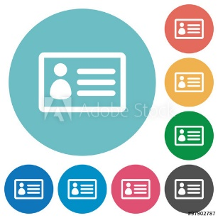




Overview of the Treatment Process
Early Identification, Screening,
and Brief Intervention
Done at earliest point possible
Determine extent and severity of disease
Comprehensive
Assessment
Stabilization
Via medically supervised detoxification, when necessary
Timely and Appropriate Substance Use Disorder Treatment
Address substance use disorder and co-occurring issues
Help parents sustain recovery, maintain family safety and stability
Continuing Care and Recovery Support
(American Society of Addiction Medicine, 2014)
Notes:
When child welfare workers have concern that a parent may have a substance use disorder, they will need to refer the parent to substance use disorder treatment. This slide provides a general overview of the treatment process from assessment through ongoing support.

Slide 23
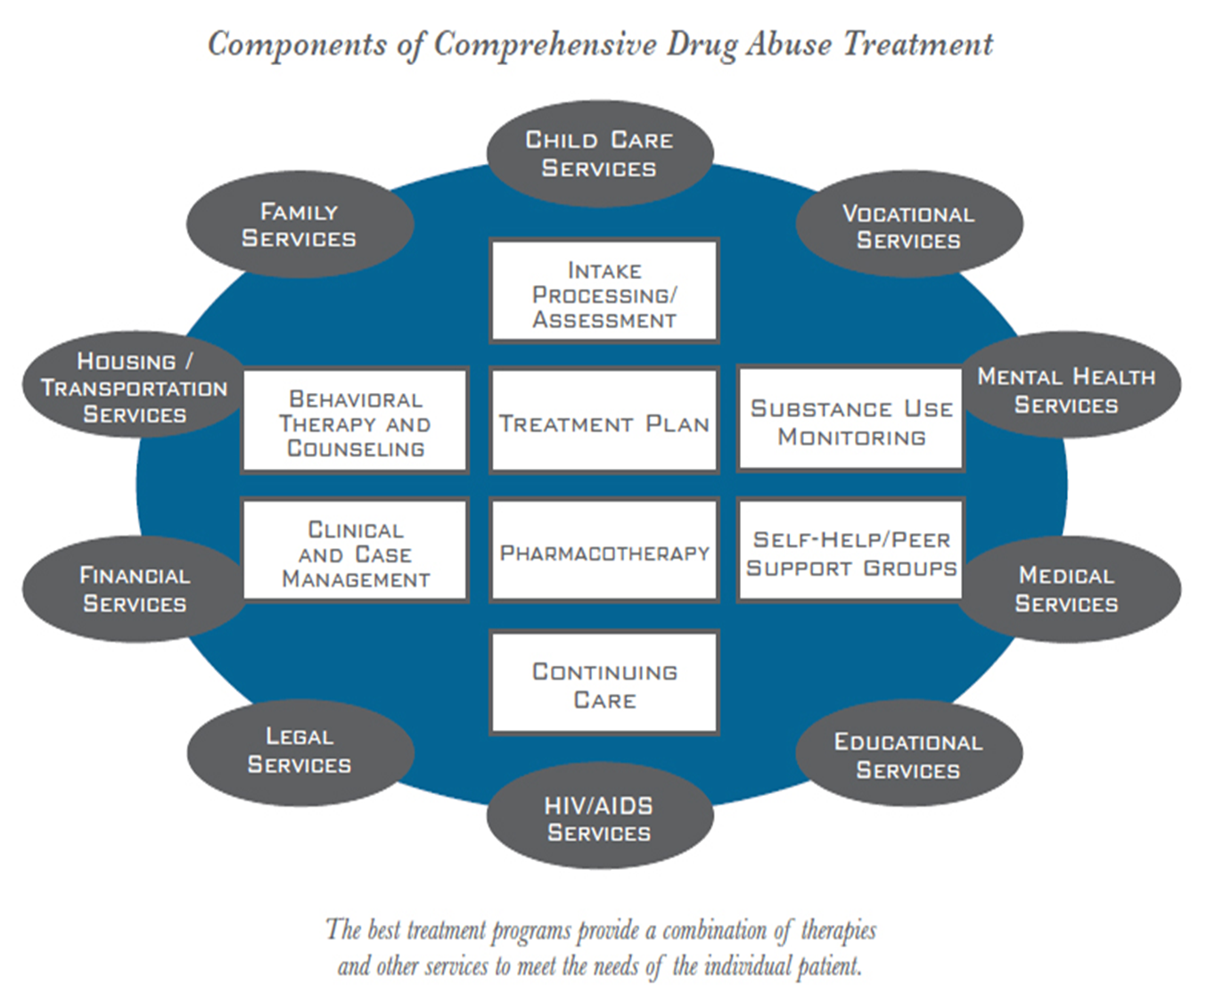

Slide 24

Mental Health Problems (1/2)
Mental Health Disorders are strongly linked to drug use and dependence.
Internalizing Disorders (PTSD, Depression, Anxiety disorders, Bipolar disorder)
Brain responses are heightened in response to stress.
Tendency to self-medicate the anxiety & depression this process causes.
Notes:
Daily social challenges may cause hyperreactivity of stress responses so that minor events become more difficult to master and/or produce anxiety and decline in self-efficacy.
More difficult to meet social task challenges which require intact neurocognitive and emotional functions that are often compromised in people with mental health issues
24

Slide 25
Mental Health Problems (2/2)
Externalizing Disorders (Conduct Disorder, Attention Deficit Hyperactivity Disorder, Oppositional Defiant Disorder, Antisocial Personality Disorder)
Low level of arousal in these disorders is related to an insensitivity to consequences and a need for more stimulation.
Heightens risk for continued drug use to relieve symptoms
Tend to be resistant to substance abuse treatment
Exacerbates stress reactivity problems
Notes:
Conduct disorder and aggression in particular is the biggest risk factor for drug use.
25

Slide 26

Personality & Temperament
A difficult temperament and certain personality characteristics are consistently related to heightened risk for drug use.
Impulsivity
Aggressiveness
Sensation or novelty-seeking
Negative affect
Impaired judgment
High activity level
Risk taking tendencies
Lack of regard for negative consequences
Lack of pain avoidance responses
Abnormal levels of arousal in response to stress.

Slide 27
Importance of Personality in Adolescence
Normal adolescence is characterized by greater reward anticipation, sensitivity, and sensation seeking—particularly social rewards (e.g., peer regard, gains in social status).
It follows that adolescence is the period during which drug use onset is most common.
And, therefore, that adolescents with especially high levels of any combination of these traits are at heightened risk.
Preventive Implications: These traits can be redirected through psychosocial means to decrease risk for drug use. Prevention programs must be designed to specifically redirect this developmental track.
Notes:
We have already seen how a good temperament can affect the attachment of caregivers (parents) to children, but it is in adolescence that this can get out of hand.
Prevention strategies will be most effective if they focus on these underlying traits, in conjunction with particular forms of environmental supports as indicated by the needs of targeted individuals, their families, and their neighborhoods
27

Slide 28

SAMHSA’S Strategic Prevention Framework
Assessment-collect data to determine the population needs, resources, and gaps.
Capacity-mobilize and/or build up resources to meet goals.
Planning-development of a comprehensive plan.
Implementation-carrying out of the plan, using evidence-based prevention programs.
Evaluation-monitoring the implementation, measuring impact, and determining needed improvements.
Always be mindful of:
Sustainability-process of integrating prevention into ongoing operations.
Cultural Competence-interacting with audiences from diverse backgrounds.

Slide 29
Prevention
WHO has recommended the prevention of substance abuse as primary prevention, early intervention, treatment, care, recovery, rehabilitation and social reintegration measures, along with measures aimed at minimizing the adverse public health and social consequences of drug abuse.

Slide 30
Successful prevention of substance use and risk reduction is thus an essential approach to achieve better public health outcomes in following disorders:
The prevention of substance-induced mental disorders and
reductions in injuries and violence (traffic and domestic injuries, child abuse, and gender-based, sexual and other violence),
reduction in communicable diseases such as HIV, viral hepatitis and tuberculosis, sexual and reproductive health problems (sexually transmitted infections, unplanned pregnancies and complicated pregnancies) and
reduction in noncommunicable diseases (such as cancer, cardiovascular diseases and liver diseases).

Slide 31
Prevention of drug abuse can be achieved by-
i) To take effective and practical primary prevention measures that protect people, in particular children and youth, from drug use initiation:
by providing them with accurate information about the risks of drug abuse,
by developing supportive parenting and healthy social environments and
by promoting skills and opportunities to choose healthy lifestyles and
by ensuring equal access to education and vocational training;

Slide 32
The family is the strongest factor in protecting children from drug use and other risky behaviour. Families that are happy communicate openly and provide a healthy environment and a positive future for their children.
Schools can cultivate sound values in their students in relation to health and drug use through the development of knowledge and providing them with coping skills to face situations which can lead to drug abuse. It is also necessary to target those who are not in school. Therefore, outreach efforts on the streets are often helpful.
Workplace: Employers can promote the health of employees by preventing substance abuse and assisting those with a drug dependence problem.

Slide 33
ii) To take effective measures to prevent progression to severe drug use disorders through targeted interventions for people at risk for such progression.
iii) Raising awareness of drug-driving and its impact on road safety including deaths, injuries, property damage and harm to other road users among the general public. Policy-makers can reduce drug-driving by enforcing drug driving laws. It is important not only to enforce drug driving laws but also to counsel and, when appropriate, treat drivers found to be impaired by drugs; especially those who are repeat offenders or those with drug-use disorders.

Slide 34
iv) Mass media can play an important role in substance abuse prevention. They can be used to raise awareness concerning not only the dangers of drug abuse but also the dangers of specific practices such as injecting drugs.

Slide 35
National Programmes related to prevention of substance abuse:
Ministry of Health and Family Welfare (MoHFW) and Ministry of Social Justice and Empowerment (MSJE), Government of India are involved with alcohol and drug demand reduction policies and drug de-addiction programme (DDAP) in the country. Under the DDAP de-addiction centres have been established in association with various District Hospitals and psychiatry departments of Medical Colleges. The centre at All India Institute of Medical Sciences, Delhi (AIIMS) has been designated as the “National Drug Dependence Treatment Centre” (NDDTC) and functions as a resource centre for the DDAP of MoHFW, GoI.

Slide 36
Various E- Health web based programmes related to prevention of substance abuse such as alcohol e-Help (alcoholwebindia.in/intervention) operated by NDDTC,AIIMS, Delhi (alcoholwebindia.in/) and m-Cessation programme (nhp.gov.in/quit-tobacco) for tobacco cessation have been initiated by MoHFW, GoI.
National AIDS Control Programme (NACP),MoHFW, GoI has implemented various targeted interventions programme for IDUs such as Needle syringe programme, Opioid substitution therapy.

Slide 37
The MSJE, GoI, has formulated the central sector scheme of assistance for prevention of alcoholism and substance (drugs) abuse and social defence services which has been updated in 2015.
The Department of Revenue, Central government acts as administrator of the Narcotic Drugs and Psychotropic Substances (NDPS) Act, 1985 and the Prevention of Illicit Traffic in Narcotic Drugs and Psychotropic Substances Act, 1988;

Slide 38
The Narcotics Control Bureau, Ministry of Home Affairs, GoI functions as an enforcement agency for NDPS Act.
Tips for prevention of substance abuse: youth
Don’t be afraid to say no.
Connect with your friends and avoid negative peer pressure.
Make connections with your parents or other adults.
Get educated about alcohol and drugs.

